Slide 1

Training/Workshop:
Build reports and workflows in CCH Tagetik
Date : 2023/07/14

Slide 2
Agenda
EPM
        EPM lifecycle
        Common EPM processes
        EPM VS ERP VS BI
        What is Enterprise Performance Management (EPM)
CCH Tagetik
        CCH Tagetik – A unified experience
        Tagetik Web Interface
Tagetik Primer
        Financial Workspace & Analytical Workspace
        Flowchart
        Terminologies des Dimension Terminology
        Structures Agregation Structures
        Aperçu des Report Overview
        Dimensions Report Mandatory Dimensions
        Financial Statement Templates - FST
  Environnement
        Dimensions
        Vision FPA VS Comptable
        Workflow
        Allocation Rules
        Cascade Allocation Rules
        Category Dimension
Report Design and Construction - training
        Excel Add-In Prerequisites
        Design Mode (Explanation)
        Design Mode (Main Features)
        Navigation
        Data Entry Mode (Explanation)
        Data Entry Mode (Main Features)
        Reports on the Web
  CCH Tagetik – Reports Design and Build
        Excel Add in – Matrice Assistance
  Advanced functions
        Parameter definitions
        Property grids
        Dynamicity
        Tagetik Style
Report Design and Construction - DEMO
Report Design and Construction - Workshop

Slide 3
EPM

Slide 4











EPM lifecycle
EPM refers to processes designed to help organizations plan, budget, forecast, and report on business performance, as well as consolidate and finalize financial results (often referred to as "closing the books").
A modern EPM solution allows you to understand how, when, and where to adapt to disruptions:
Optimize financial closing.
Streamline account reconciliation.
Generate accurate and agile integrated plans.
Manage and drive profitability.
Meet all your reporting requirements.
Handle change with enterprise data management.
Analyze performance
Strategic modeling
Opérations
RH
Finances
TI
Report
Planning and budgeting
Ventes
Marketing
Consolidation and closing

Slide 5
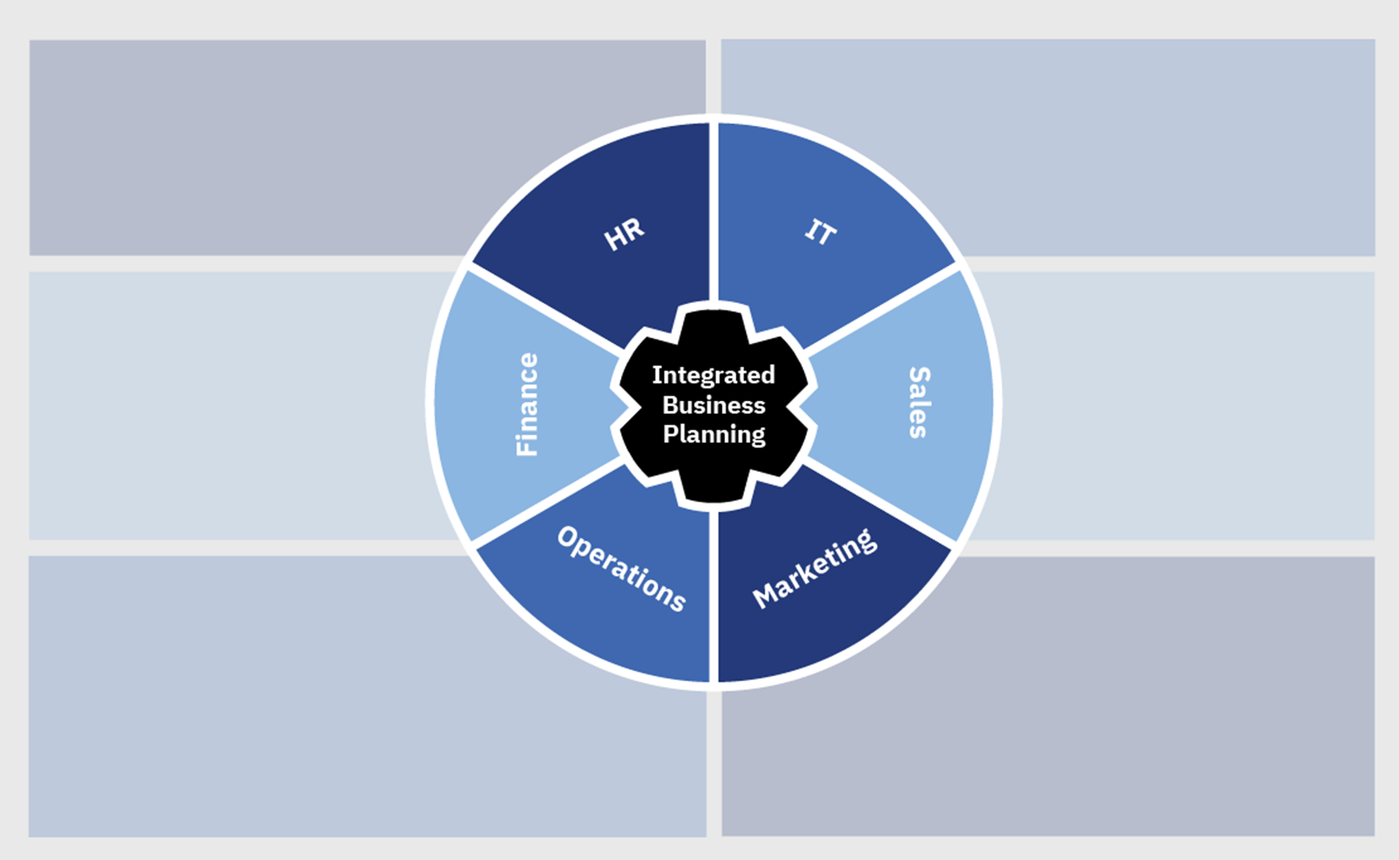
Common EPM processes
HR
Workforce planning
Workforce and personnel planning
Salary and compensation planning
Employee performance indicators
Training and development
IT
IT portfolio planning
IT budgeting
Shared services planning
Project planning
Finance
Financial planning and analysis
Strategic planning
Capital planning
Expense planning
Allocations
Business dashboards
Profit and loss
Balance sheets
Sales
Sales forecasting
Sales territory planning
Sales quota planning
Sales capacity planning
Sales dashboards
Incentive compensation
Operations
Demand planning and analysis
Supply chain planning
Sales and operations planning
Capacity and inventory planning
Operational Key Performance Indicators (KPIs)
Product allocations
Marketing
Promotion planning
Revenue planning
Customer and product profitability
Campaign scorecards
Customer churn analysis
New product planning

Slide 6
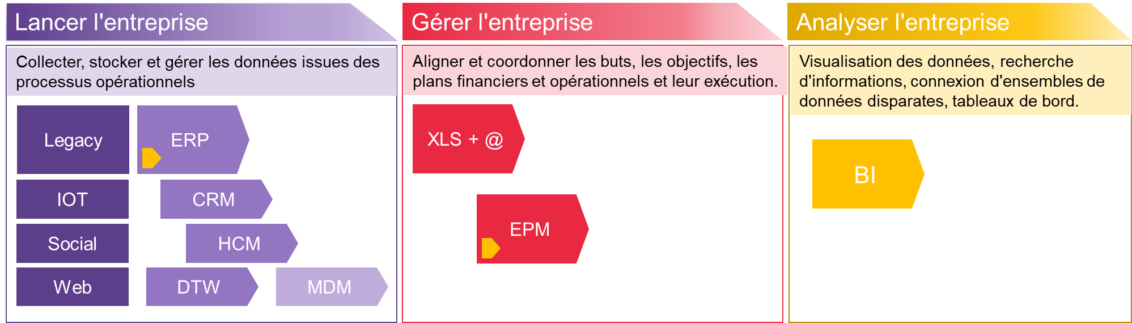
EPM vs ERP vs BI
Manage the Entreprise
Drive the activity
Analyze the activity
Collect, store, and manage data from operational processes.
Align and coordinate goals, objectives, financial and operational plans, and their execution.
Data visualization, information discovery, connecting disparate datasets in dashboards.
Finance | Other departments
Accounts receivable | Customer satisfaction
Accounts payable | Material requirements planning
Invoicing | Contractual purchases
Cash management | Project resources
Payments | Service orders
Assets | Distribution (supply)
General ledger | Product recalls
Finance | Other departments
Planning, budgeting, forecasting | Workforce planning
Expense planning | Sales and margins
Allocations | Personnel planning
Profit loss, balance sheet | Demand planning
Cash flow, Capex | Capacity planning
Financial reports | Promotion planning
Consolidation, elimination | Incentive compensation

Slide 7
What is Enterprise Performance Management (EPM)?
EPM or ERP ?
ERP systems focus on automating transactional processes, while EPM systems focus on automating management processes used to drive and enhance performance.
EPM vs. Business Intelligence (BI) Tools
Both fall under the business analytics segment. However, BI is an information delivery platform:
BI is an information delivery-focused platform primarily designed for IT departments, deployed to operational users for general-purpose reporting and analysis throughout the enterprise.
EPM software supports a set of processes typically driven by the financial organization and extending to business lines. It contributes to processes such as modeling, planning, consolidation, reporting, and analysis.

Slide 8
CCH Tagetik

Slide 9

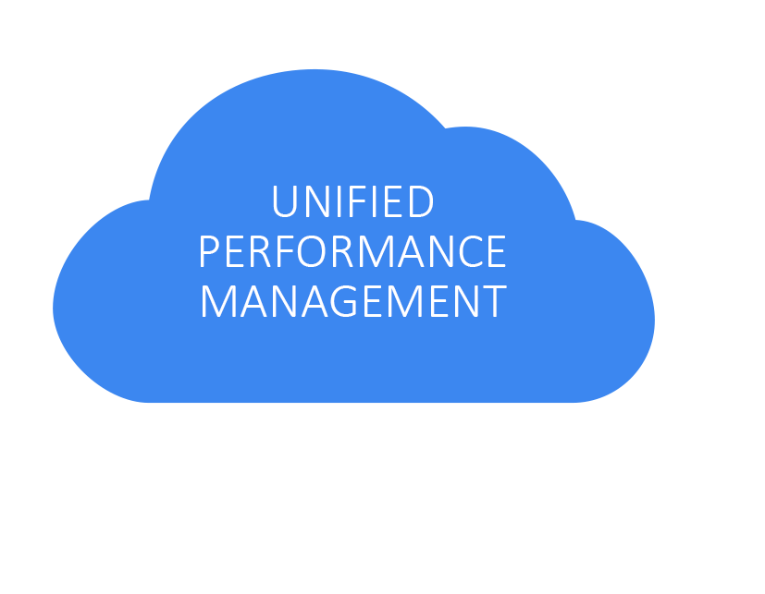




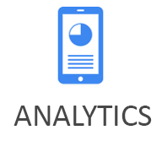
CCH Tagetik – A unified experience
CCH Tagetik is an Enterprise Performance Management (EPM) software designed to automate and simplify complex financial processes. It enables businesses to streamline tasks such as budgeting, forecasting, financial consolidation, and reporting.
With CCH Tagetik, companies can achieve a unified view of their financial and operational data, facilitating more accurate and informed decision-making. It is particularly valuable for financial departments that require a high level of control, visibility, and efficiency in managing their financial operations.
Notes:
Our approach unifies all of these finance processes in one application, reducing the volume of manual tasks and redundant data; decreasing the cycle time of close, planning and reporting processes, incorporating analysis during the cycle rather than after, and actually reduces the number of systems you need to run finance.
Tagetik delivers the power to manage all of this in a solution that is still owned and operated by Finance without tying up IT resources. And we can do it on the cloud even if your finance processes are very complex or unique. But most importantly, whether on the cloud or on-premises,

Slide 10
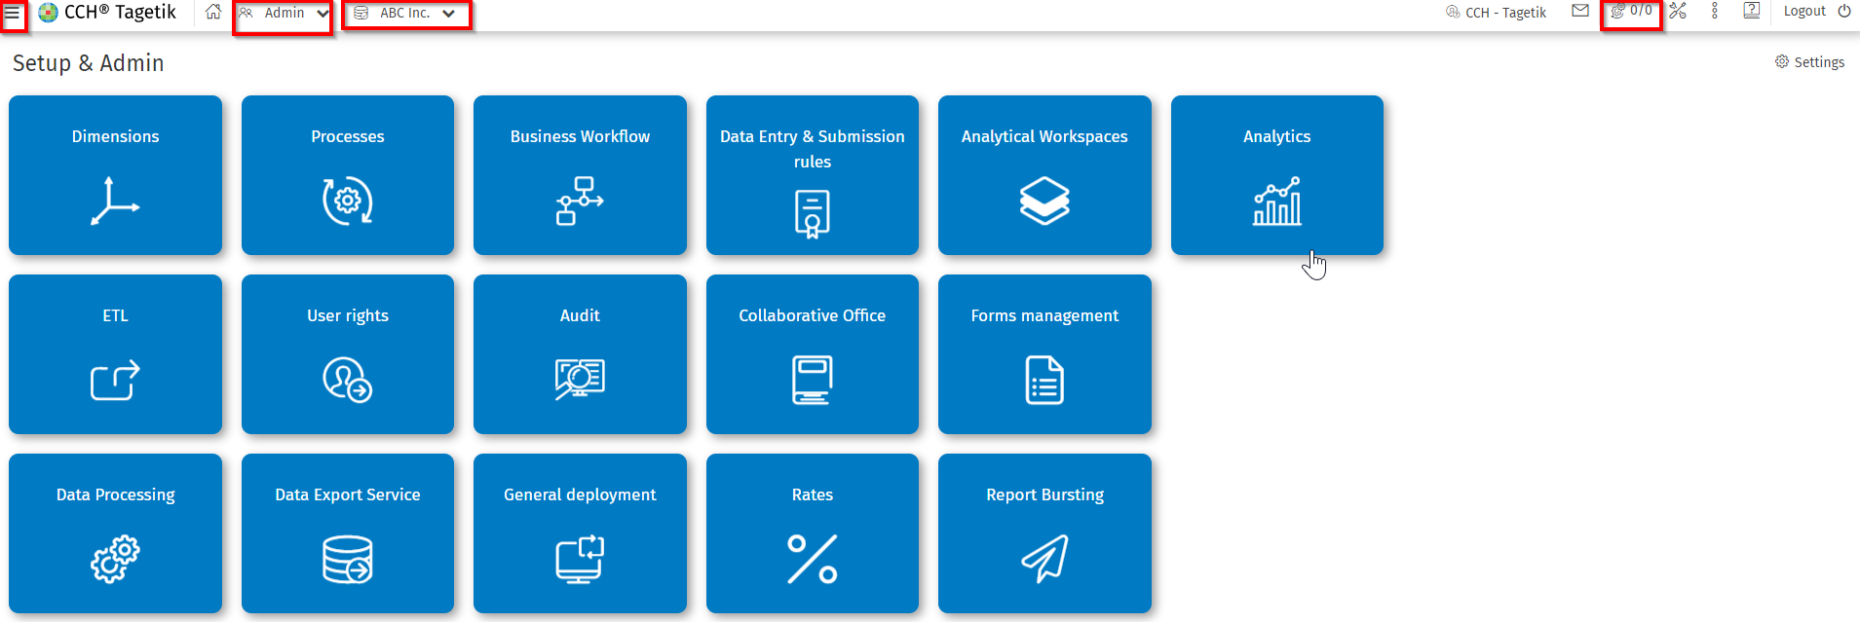
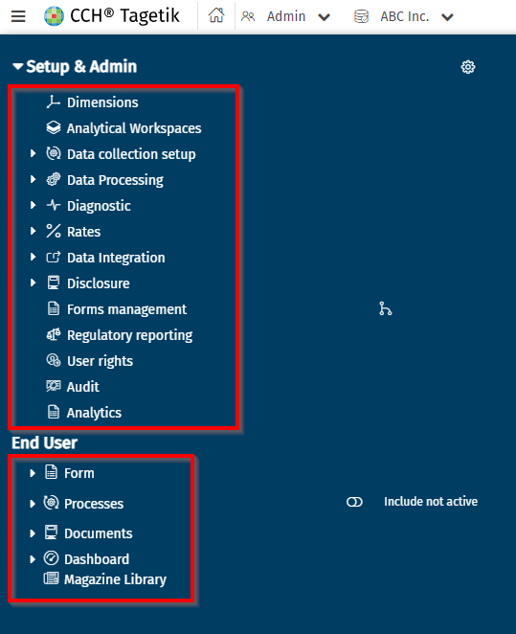
CCH Tagetik Web Interface (1)
AdministratOr
Quick access to the User/Admin panel
Switching to the ADMIN/User interface
Switching to other databases
Check the status of ongoing processes
Administrator Menu
Administrator Interface
User Menu

Slide 11
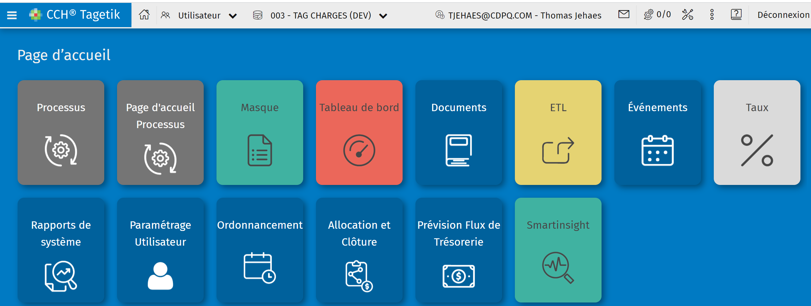
CCH Tagetik Web Interface (2)
USER
User Interface
Notes:
Screenshot a changer interface dans le TUP different de celui chez les clients

Slide 12
CCH Tagetik Primer

Slide 13
Financial Workspace & Analytical Workspace
    Financial Workspace :
      In general, a financial workspace in an EPM tool is a centralized and customizable interface that allows users to easily access key financial tasks, reports, and key performance indicators (KPIs). A Financial Workspace can facilitate the integration and management of data from various sources to ensure accuracy and consistency of financial data.
    Analytical Workspace :
      This is a workspace that enables the loading and processing (data management or modeling & analysis) of granular/detailed financial or operational data. Use cases for workspaces include analyzing profitability at a very detailed level or storing transactional data. Each of these use cases represents a distinct "workspace" to be configured.
Notes:
Remplacer jaune par les termes allocation du client actuel

Slide 14
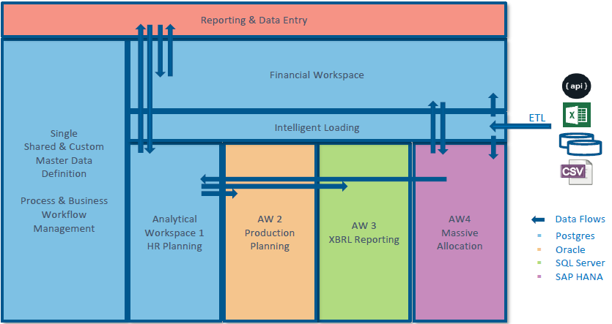
Flowchart

Slide 15
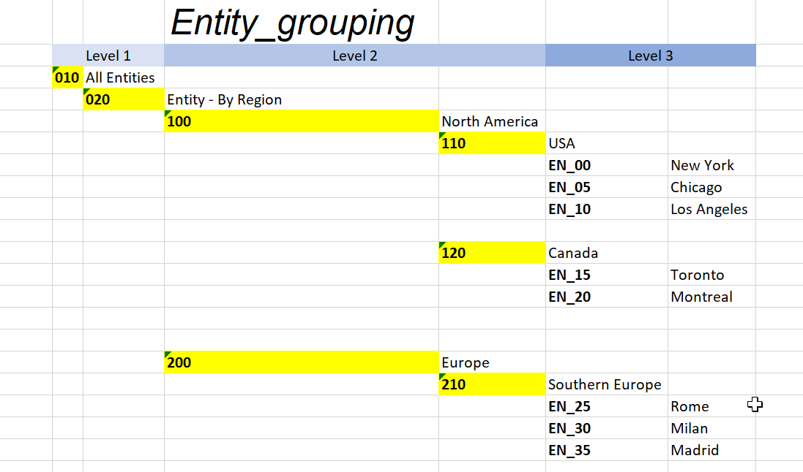
Dimension Terminology
    Tagetik has a multidimensional data model defined by 3 types of dimensions:
    System Dimensions (Ex: Entity, Scenario,..).
    Custom Dimensions (Ex: Cost Center, Employee).
    Analytical Dimensions (From Analytical Workspace).
    Two terms are applicable for all dimensions:
    Base Elements
      The lowest level of information for a particular dimension.
      Data is recorded at the level of the base element.
      Flat list of values (similar to entity lists)
    Parents Nodes
      An aggregation of base elements.
    Example of entity dimension
Parent Node
Base Elements

Slide 16
Agregation Structures
    Two structures (“Hierarchy”):
    In grouping, there are no restrictions on base elements, whereas in hierarchy, a base element can be grouped only in a single node.
    Aggregation allows for a different analysis of the base elements within a dimension.
 | Hierarchy | Groupements | Without Agregation
EntitY | ✓
Account | ✓
Custom Dimensions | ✓
Scenarios |  | ✓
Categories |  | ✓
Periods |  |  | ✓
Currencies |  |  | ✓

Slide 17
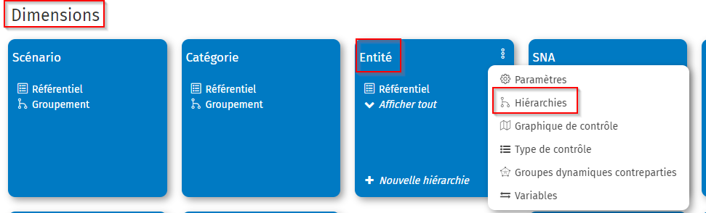
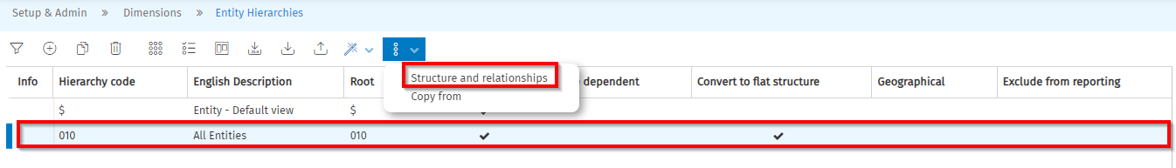
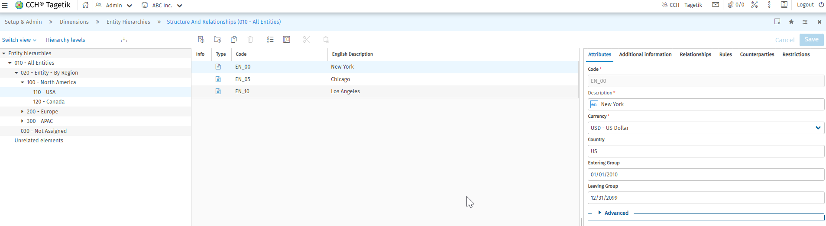
Agregation Structure in CCH Tagetik
Exemple: Entity – HiErarchy
Parent Node
Base Elements

Slide 18
Report Overview
    Reporting using Excel Add-in
    Different types of reports :
      Output Report – Used to look at data
      Date Entry (DE) Form – Allows for entry of data that is saved in the database
      Ad Hoc Report – Report created by an individual user that is stored on their local machine
        Cannot be used by other users unless stored on a shared folder that others can access
      A DE Form can also be used as an Output Report
Purpose/ Access | Output | Data Entry
Shared | Report/DE form | DE form
Local | Ad hoc Form | ✗

Slide 19
Report Mandatory Dimensions
    Scenario
    Period
    Period Length
    Amount Type
    Account
    Entity
    Category
    Custom Dimensions ( if enabled)
Mandatory
for
Output Forms
Mandatory
for
DE Forms

Slide 20
Financial Statement Templates (FST)
    Tagetik uses FSTs to facilitate report creation
    Multiple reports can use the same FST
    Can include accounts and formulas
    Alternative aggregation structure
    2-level structure:
      Parent/Formula/Description
      Account / Custom Dimension
        Can have the same account on two rows as long as there is a unique custom dimension member

Slide 21
Environnement

Slide 22
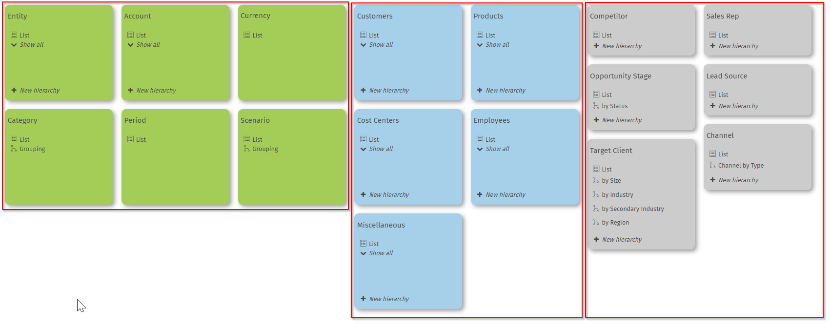
Dimensions
MandatoryDimensions
Costum Dimensions
Analytical Dimensions

Slide 23
Allocation: Analytical View vs. Accounting View
    Desire for more analytical capability for both "senders" and "receivers" to better understand the type of allocated expenses and their original sources.
    The FPA (Financial Planning & Analysis) and Accounting processes are divided into two parts:
      Allocation from the FP&A Perspective:
        Providing full visibility for analysis in terms of cost centers and original entities, the type of rules applied to a given allocated amount, or the impact of direct allocation versus indirect allocation for a specific project.
      Allocation from the Accounting Perspective:
        Based on the results generated above, the necessary accounting entries will be generated by CCH Tagetik using a data processing procedure.
Notes:
Voir si a garder car specifique au client

Slide 24
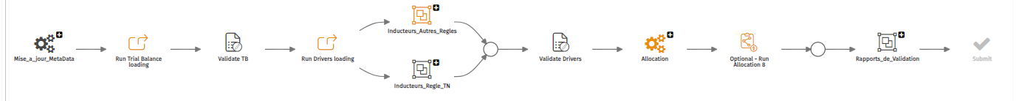
Workflow
Allocation
Allows processing the various stages of the allocation process following the loading of the trial balance.
*Allocations are managed in cascades within Tagetik (See next slides)
Notes:
Faut il mettre n workflow generique de DB de TUP

Slide 25
Règles d’allocation
Règle | Description | Allocation
R001 - Services de données | Répartition en deux étapes des dépenses de services de données | 1ère étape : Allocation par Entité(PS) et SNA. 2ème étape : Allocation du montant restant par Centre de Coûts.
R002 - Technologie Numériques (TN) | Répartition des dépenses TN
R003 - Frais de garde | Répartition en deux étapes des dépenses des frais de garde | 1ère étape : Allocation par Entité(PS) et SNA. 2ème étape : Allocation du montant restant par Centre de Coûts.
R004 - Frais de gestion externe | Répartition en deux étapes des frais de gestion externe | 1ère étape : Allocation par Entité(PS) et SNA. 2ème étape : Allocation du montant restant par Centre de Coûts.
R005 - Services généraux | Répartition en deux étapes des dépenses des services généraux | 1ère étape : Allocation par Centre de Coûts direct 2ème étape : Allocation par Entité(PS) et SNA
R006 - Regroupement PFA équipes liées aux PS | Sondage % par SNA Admin | Allocation par Entité(PS) et SNA
R007 - Allocation Caisse Mondiale | Caisse Mondiale vers PS | Allocation par Entité(PS) et SNA
Notes:
Voir si a garder car specifique au client

Slide 26
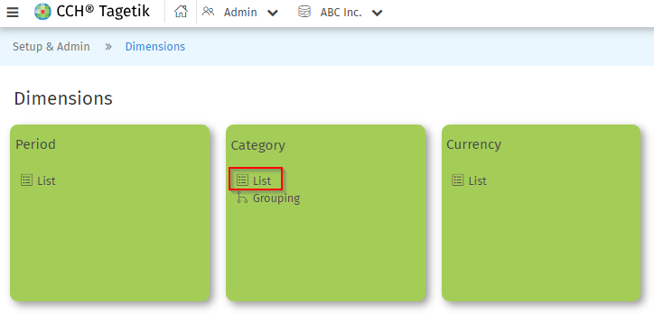
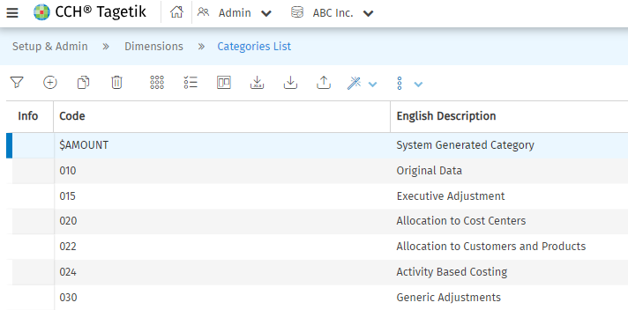
Category Dimension
Category is a fundamental dimension in Tagetik, as it enable users to classify and segment data (including adjustments) and thus track how data is generated.

Slide 27
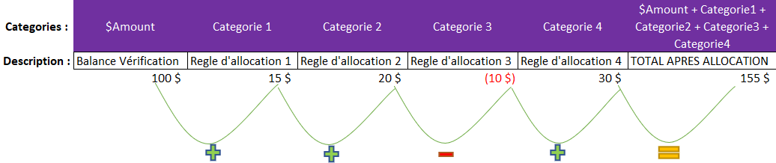
Illustration of how the Category dimension works
*This dimension will allow us to closely track the path of allocation rules.
Notes:
Specifique au client ?

Slide 28
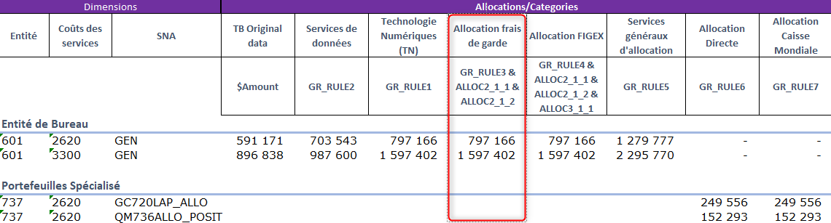
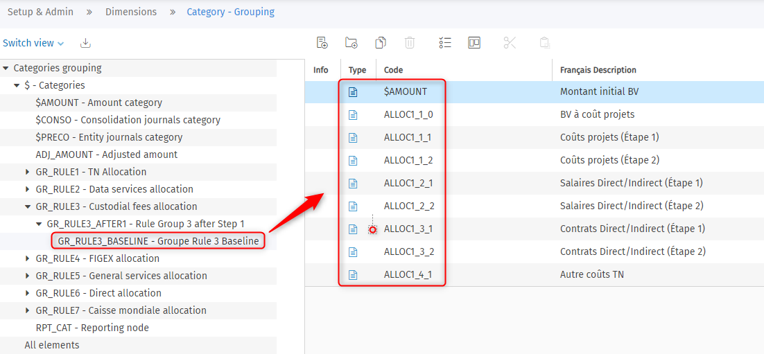
Règles d'allocation gérées en cascades
$Amount : 591 171
ALLOC1_1_2 : 20 665
ALLOC1_2_2 : 39 470
ALLOC1_3_2 : 27 990
ALLOC1_4_1 : 5 499
ALLOC2_1_2 : 112 372
SUM : 797 166 $
La donnée dans la colonne Allocation frais de garde est une agrégation de la TB Original amount et de toutes les variations provenant des allocations précédentes.
Notes:
Voir si a garder car specifique au client

Slide 29
Report Design and Construction - Training

Slide 30
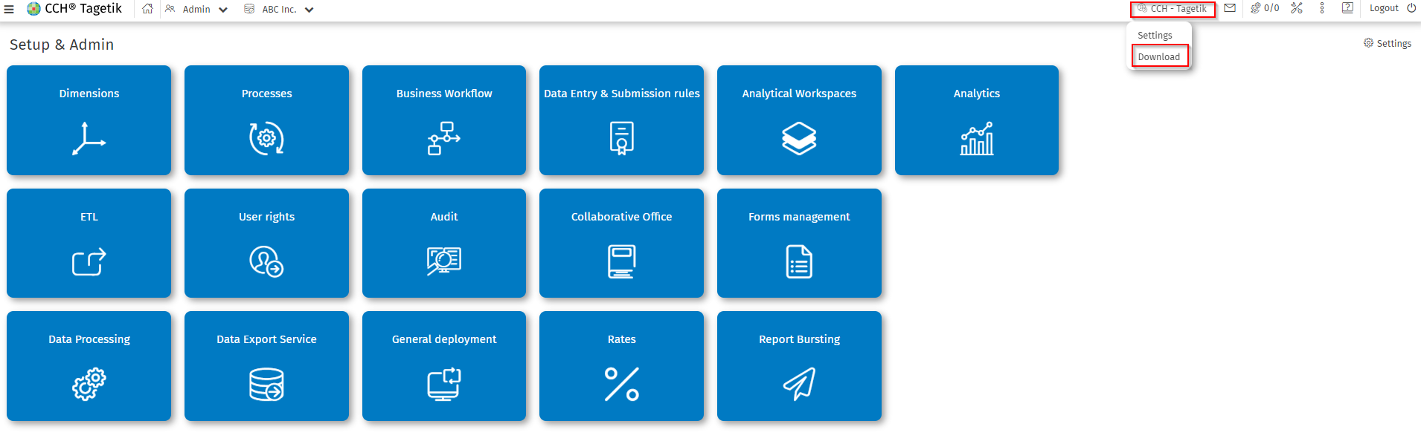
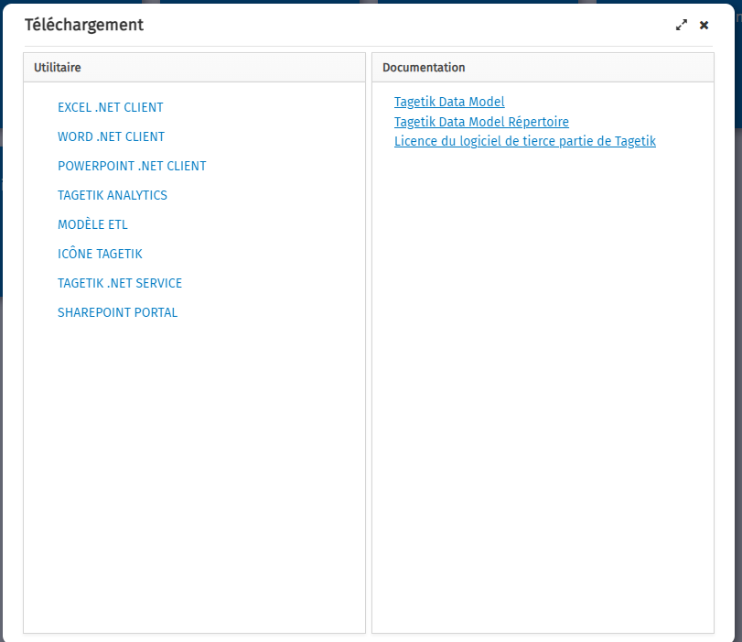
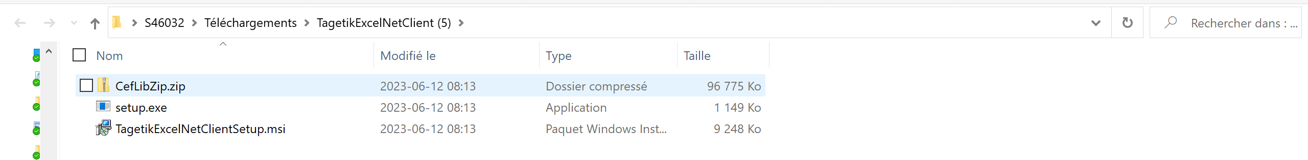
Excel Add-In Prerequisites (1)
    You can download it from the homepage of the web interface by clicking on your name, then on "Download," and then on "Excel Client.NET."
After selecting the "setup.exe," follow the different prompted steps.

Slide 31
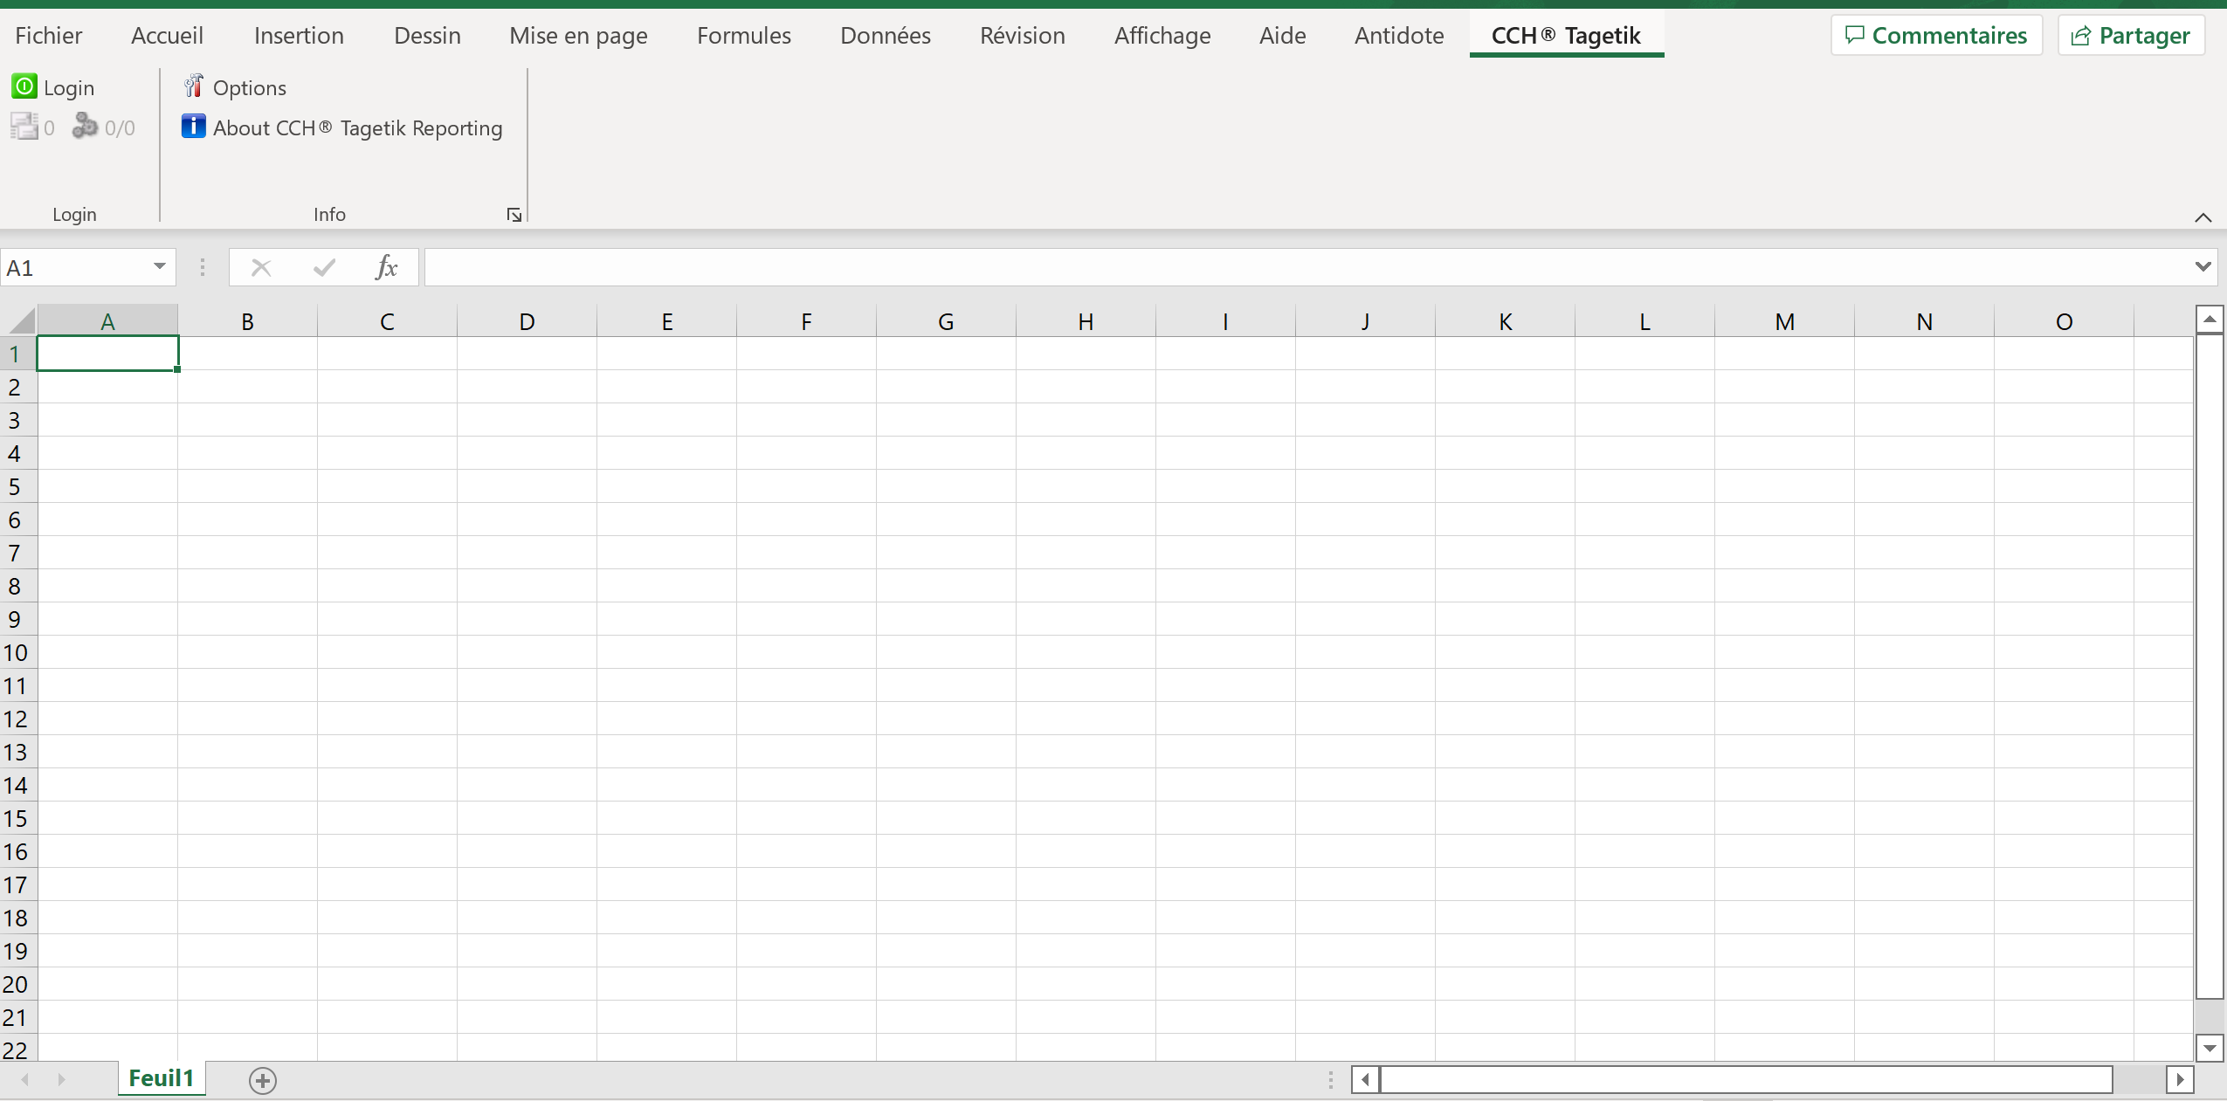
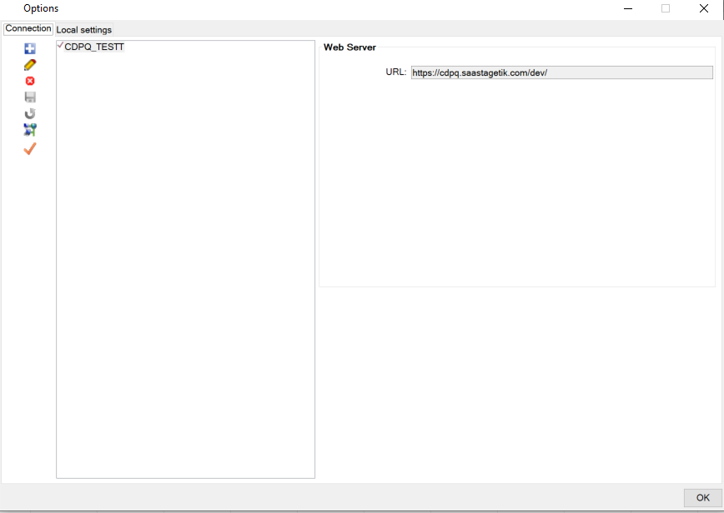
Excel Add-In Prerequisites (2)
    Once the Add-In is installed, you will need to create a connection to the environment before logging in.
    Open an Excel sheet, go to the CCH Tagetik section, and select "Options."
    Create a new configuration with the URL link : https:// .saastagetik.com/dev/
1
4
2
3
Click on the "+", enter the database name, in the Web Server section, enter the link. Select the "checkmark" to choose the database after saving.
Notes:
Mettre un exemple en connectant la base du TUP ?

Slide 32

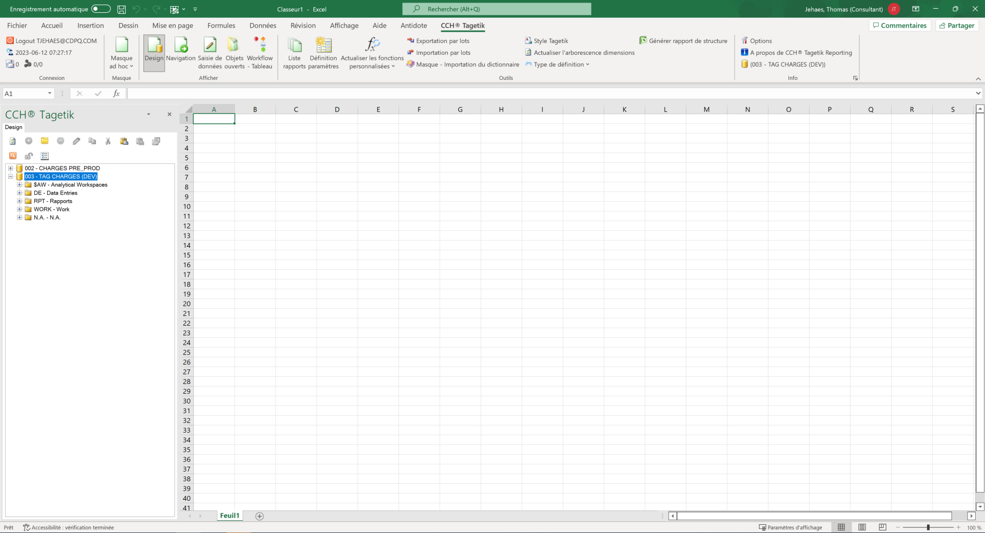
Excel Add – In
    Additional tab called "CCH Tagetik“
    Once connected, here is the workspace:
CCH Tagetik Ribbon
Left Pane
Work Area
Notes:
Refaire le screen shot

Slide 33

CCH Tagetik – Design Mode
    Create a new form
        The forms are managed like all other Tagetik dimensions: they have a table that includes the list of all existing forms and can be grouped in an aggregation structure. Each form is identified by:
          a code;
          a description
    Manage form groupings
      Tagetik allows you to define for the forms a “grouping” type aggregation structure in order to sort the various forms
    Ad hoc form
      The ad hoc form is an output form saved locally by the user and, as its name suggests, is aimed at meeting specific needs of single users and not for a centralized and shared usage. The ad hoc form is equal to a normal form but, when saving, it is not saved into the Tagetik application database but the system asks to specify the target directory
    Specific dimensions when designing reports
      Amount type
      Period length

Slide 34






Design Mode – Key functionalities
Fonctionnalités | Description
 | Mask Filters: Filters to define filters to be applied to the entire mask, meaning to all models that belong to the mask.
 | Sheet Filters: Definition of filters to apply to each selected model.
 | Matrix: To define a set of data using row/column/matrix filters (context).
 | Cell Field: Allows creating a cell field at the selected cell level in the workspace.
 | Segmenter: Opens the window to define a new segmenter to be associated with the selected cell in the workspace.
 | StyleTagetik: Opens the window for managing style sheets.
 | Dictionary Element: Creation of a dictionary term at the selected cell level in the workspace.
 | Query: Definition of an SQL query.
Paramètres | Quick filter on a dimension during report execution. Can be used within a mask as a row/column filter, matrix filter, or sheet filter.

Slide 35

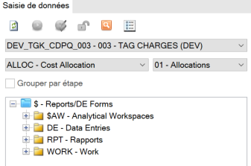
Mode de saisie de données (Data Entry)
      A form can be designed to allow end users to adjust existing data in the data base or insert new ones. In that case, this is called a Data Entry form.
      A DE form is run via the Data Entry mode, using a specific process (ex: Budgeting) and a workflow step.
      During the form design, the user need to define editable cells, so the form
      Can be used in Data Entry mode

Slide 36
Data Entry Mode (Data Entry)
    Key functionalities:
      Spreading: allows the end user to insert the value based
      Add comment: abiility to add commnt and attach documents in specific cells. This will be stored in the CCH Tagetik database.
      Save to « send »: data are not stored in the CCH Tagetik database when inputing. The user needs to save to « send » the data to the database.

Slide 37

Navigation
      Each form (Report or DE form) can be run in navigation mode
      Data displayed are read from the CCH Tagetik database, filtered according to the different filters set up during the design step.
    Key functionalities:
      Cell properties: for each cell, ability to display information related to it
      Drill Down: when aggregated data (ex: account grouping), ability to display more granular data
      Drill Through: ability to display transactional data which are stored in an external system or in a detailed table in CCH Tagetik

Slide 38
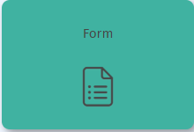
Reports on the Web
      Each from (Reports or DE form) are available and can be displayed using the end-user web interface
      More convenient for end users who don’t have the Excel add-in installed
      Only in Navigation or Data entry mode (Design must still be done using the Excel Add-in)
      Same functionalities are the same on web and Excel (Cell properties, Drill down, Drill through)
Notes:
Changer le screen pour montrer qu’pon est bien dans le web.

Slide 39
CCH Tagetik – Reports Design and Build

Slide 40
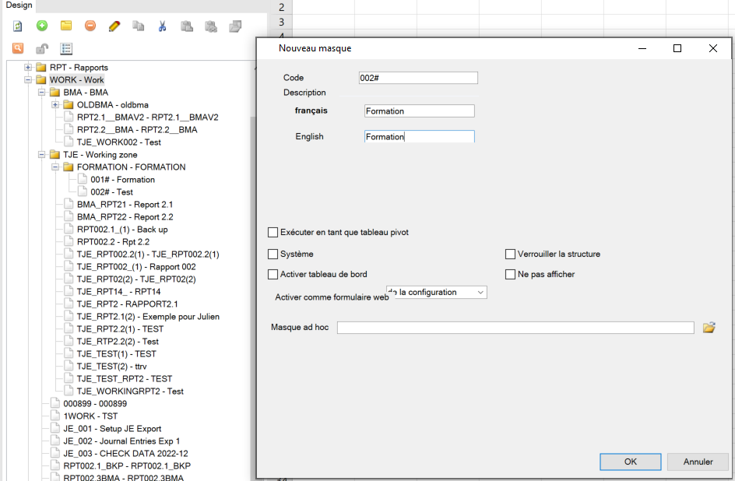
Add-In Excel – Report Creation
To delete a Report
To Create A Report
Report Code
Report Description

Slide 41
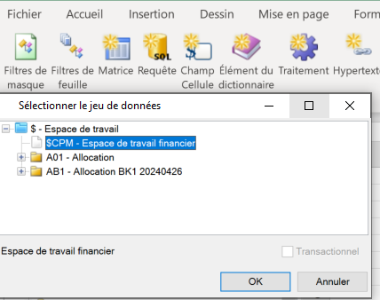
Add-In Excel –Matrice Assistance (1)
Features | Descriptions
Add to | Adds a filter for each selected element.
Add to All | Adds the element to all filters already defined in the rows section.
Add OR as a new element | Adds the selected element(s) in OR to an already inserted element belonging to the same dimension.
Add in OR | Adds a combination "in OR" of the selected elements.
Add dummy parameter | The system adds an element with an icon indicating that it's an empty row/column.
Formulas | Allows adding elements of formula types.
Matrice Creation
#

Slide 42
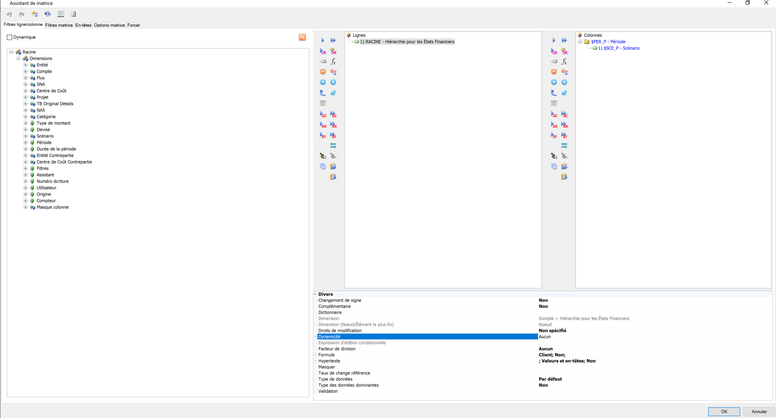
Add-In Excel – Matrice Assistant (2)
Matrix Filters & Headers
Add dummy paramete
Add To
Add To All
Add Formula
Add OR as a new element
Add in OR
Period and Scenario Parameter
Account Dimension Filter
Dimensions
Report-specific Dimensions
Row Filter
Column Filter
Properties

Slide 43
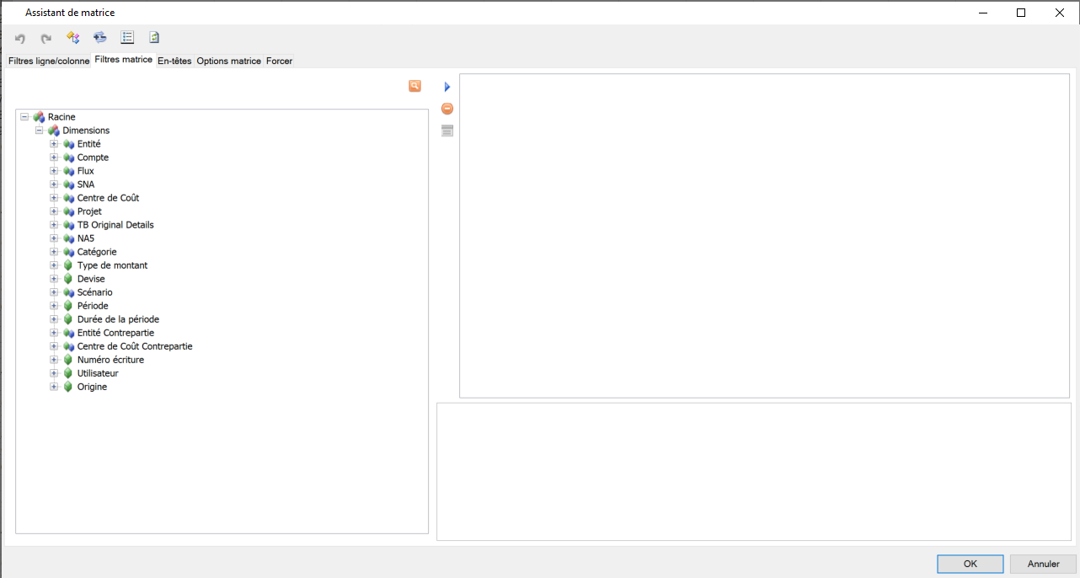
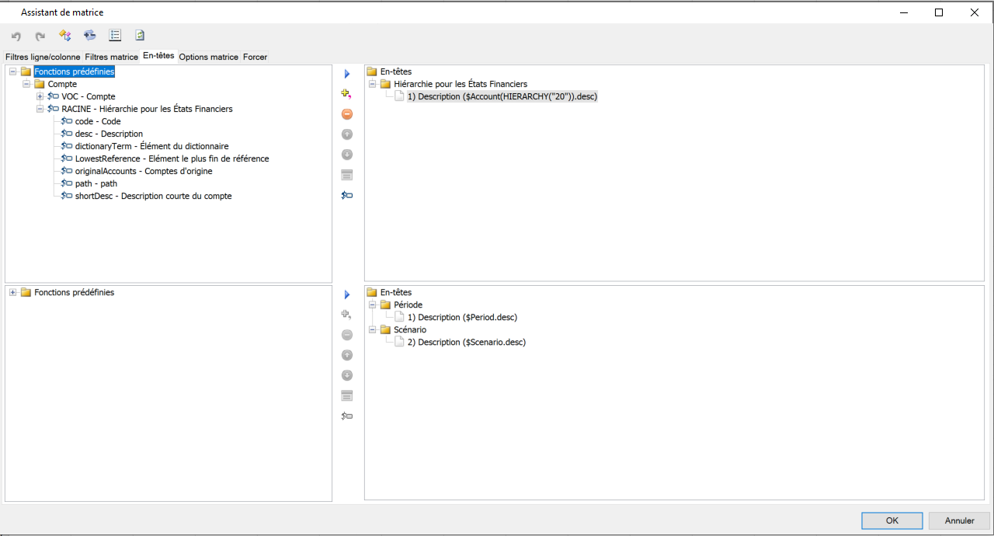
Add-In Excel– Matrice Assistant (3)
The header allows:
Displaying each header on a separate row/column of the matrix.
Displaying headers on a single row/column of the matrix.
Adding information like description and code.
Using advanced dynamics.
Hiding rows/columns.
Matrice Filter
Row Header
« .desc » = Show description.
« .code » = Show code.
EX: « $Account.desc +$Account.code » : Allows displaying the code and description of accounts.
Matrix filter is a type of filter that acts on the entire area of a matrix in a mask, not just on the rows and columns.
Column Header

Slide 44
Advanced functions

Slide 45
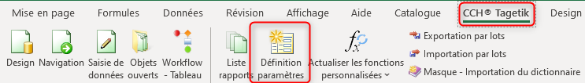
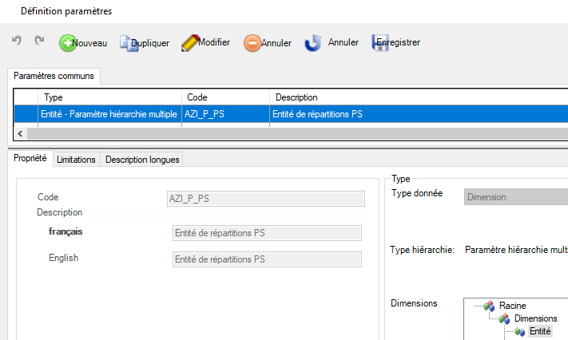
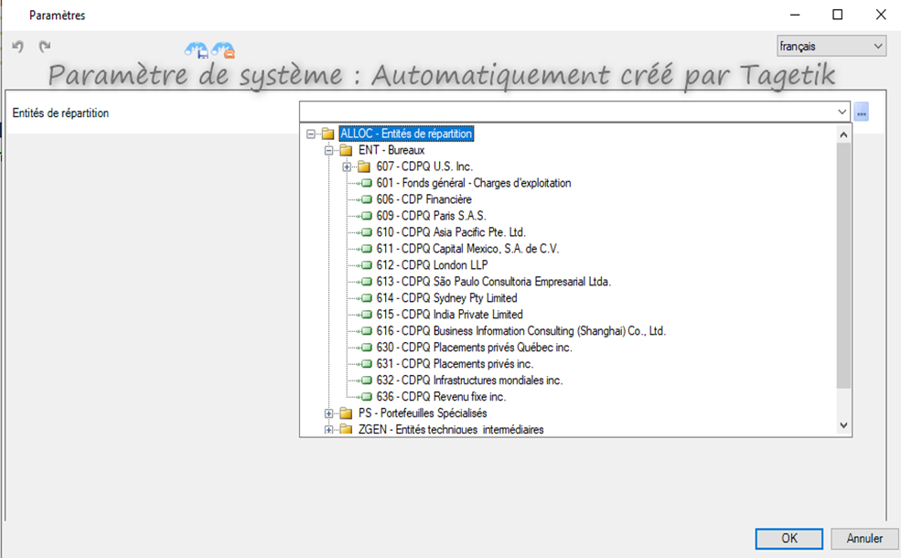

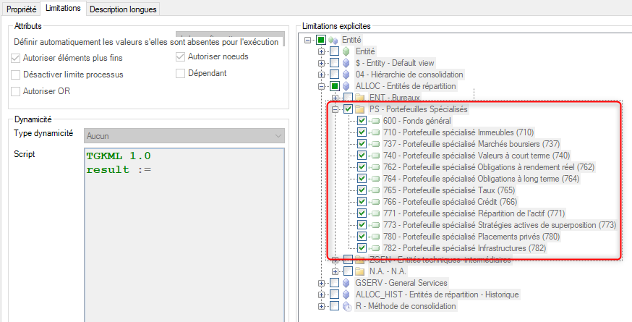
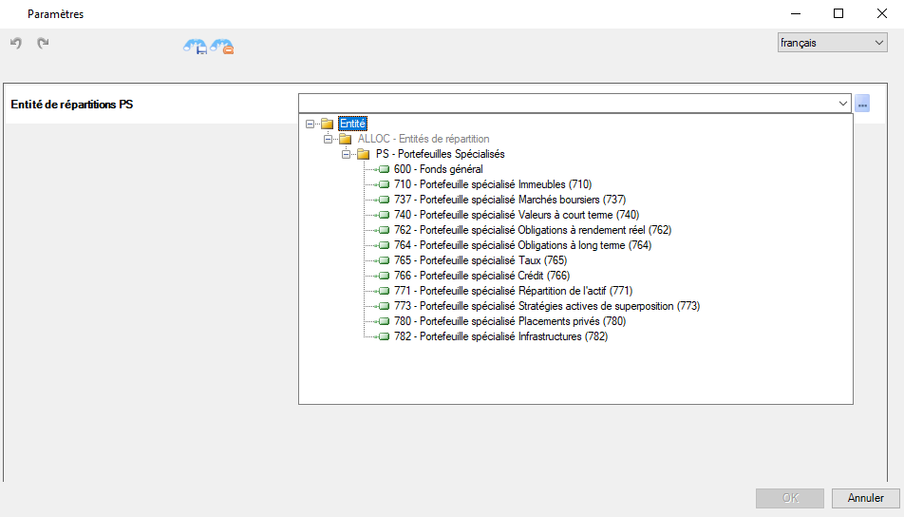

Parameter definitions
Notes:
Screen shots a changer

Slide 46
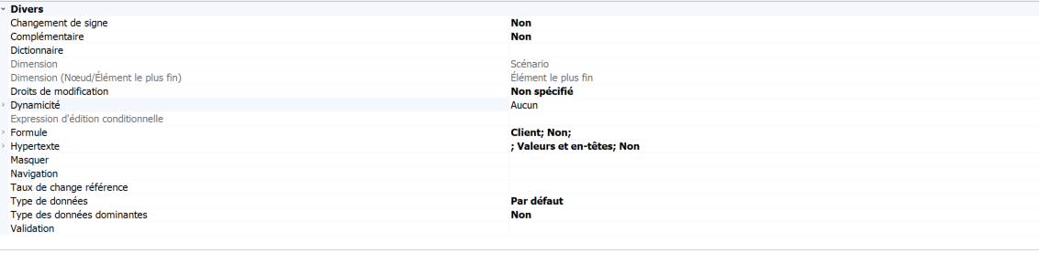
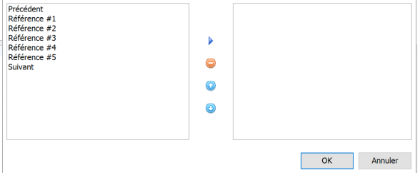
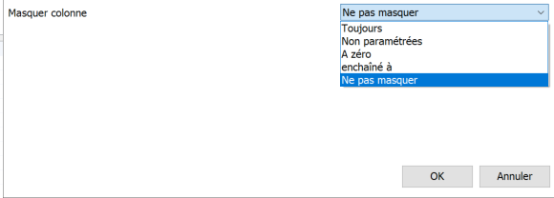
Property grids
Dictionnary
Dynamicity
Navigation
Hide
Formulas
Allows selecting a navigation criterion through scenarios.
Allows selecting certain criteria to instruct the system to hide the element.

Slide 47
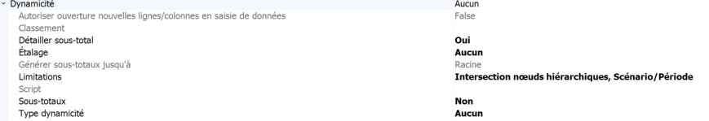
Dynamicity Types
Dynamicity
Pruning: Eliminate rows or columns that are empty.
Subtotals: To display a subtotal
Dynamicity Types :
Insert Parent: Displays the parent node of the specified element.
Insert Children: All corresponding rows to the child nodes of the specified node are inserted at runtime.
Insert Lowest Level Items: All leaf nodes of the specified node as filtered are inserted at runtime.
Advanced Dynamics: This option allows inserting dynamic elements that cannot be inserted by standard dynamics.

Slide 48
Advanced Dynamicity
ExAmples
Script | Descriptions
TGKML 1.0 result := this.lowest; | Displays the leaf elements of the node on which dynamics are active.
TGKML 1.0 result := this.descendants(2); | Displays the second level of hierarchy of the node on which dynamics are active.
TGKML 1.0 a:= $Scenario.currencyScenario.code; b:= $Currency.GETLEAF(a); result := b; | Take the currency of the scenario.
TGKML 1.0 a:=this.all.select("$Period.code","<=", @$PER_P.code); result := a; | Make the period column dynamic according to a parameter.
TGKML 1.0 a:= this.getnode(yournode); b:=a.lowest; result:=a+b; | Allows seeing the node along with all leaf elements, excluding intermediary elements.

Slide 49
Tagetik Style
Tagetik Style allows defining a specific layout.
It enables defining styles to apply to masks to select the font, character dimensions, etc.
 | Tagetik Style | Excel Format
Positive aspects | Manages matrix formatting dynamically. | Can be applied to non-dynamic matrices and queries.
 |  | Applicable to elements outside matrices/queries. (e.g., Titles, Headers, etc.)
 | Applies to multiple reports automatically. | Quick setup time.
Negative aspects | Has certain limitations in formatting. | Non-dynamic.
 | Initial formatting time and maintenance. | Needs to be manually replicated on a new report.

Slide 50
Report Design and Construction - DEMO

Slide 51
Report Design and Construction - WORKSHOP

Slide 52
CAS_A_0
      1. Introduction
      Nous allons explorer ensemble les données financières de 2023ACT, période 03 de l'entité 601.
      2. Identification des comptes
      Tout d'abord, veuillez afficher la BV de la liste d'éléments fins du nœud 5000 - Salaires et avantages sociaux.
      Pour ajouter une couche de clarté, nous allons ajouter le code des comptes à côté des descriptions.
      3. Formatage des nombres
      Ensuite, nous devons nous assurer que nos données sont présentées de la manière la plus lisible possible.
      Veuillez passer en revue vos données et ajuster le formatage des nombres selon les conventions appropriées.
      4. Validation du croisement de dimensions
      Une fois que nos données sont bien organisées et formatées, il est temps de confirmer l'intégrité de nos données en validant le croisement de dimensions.
      Utilisez la fonction "Propriété cellule" pour valider le croisement de dimensions pour un montant.
      5. Conclusion
      En suivant ces instructions, vous serez en mesure d'analyser efficacement la BV de la liste des éléments fins, tout en vous assurant que les données sont bien organisées, formatées et validées.

Slide 53
CAS_A_1
      1. Introduction
      Maintenant, notre tâche est d'analyser le montant alloué sur le PS 737 à la fin de l'allocation 5.
      EXTRA :
      2. Affichage des données initiales
      Affichez séparément la donnée avant toute allocation.
      3. Calcul de la variation
      Utilisons une formule pour calculer et afficher la variation entre la donnée initiale et la donnée à la fin de l'allocation 5
      4. Affichage du code de la dimension
      Afin de faciliter notre analyse, affichons le code de la dimension Catégorie en plus de la description.
      5. Ajustement du format
      Maintenant, prenons le temps d'ajuster le format manuellement pour une meilleure lisibilité.
      6. Personnalisation du masque
      Pour rendre notre document officiel, ajoutons le logo .
      7. Ajout du dictionnaire
      Nous allons maintenant enrichir notre document en ajoutant le dictionnaire "CAISSE DE DÉPÔT ET PLACEMENT DU QUEBEC".
      8. Ajout du champ de Cellule
      Enfin, ajoutons le champ "Report.desc" en dessous du dictionnaire pour compléter notre analyse.
      9. Conclusion
      En suivant ces instructions, vous serez capable de faire une analyse approfondie et précise du montant alloué sur le PS 737 à la fin de l'allocation 5.

Slide 54
CAS_A_2
      1. Introduction
      Notre objectif est de déterminer le dernier Centre de Coûts et la dernière entité de laquelle le PS 737 a reçu des dépenses dans le cadre de l'allocation 5.
      2. Création de CAS_A_2
      Créons un nouveau masque CAS_A_2 à partir du masque existant CAS_A_1.
      3. Ajout de la dimension Centre de Coût
      Ensuite, nous allons enrichir notre analyse en ajoutant la dimension Centre de Coût.
      4. Ajout de la dimension des Entités de répartition Contrepartie
      Pour terminer, nous ajouterons la dimension des Entités de répartition Contrepartie pour avoir une vision complète.
      5. Conclusion
      En suivant ces instructions, vous pourrez analyser plus en profondeur l'origine des fonds reçus par le PS 737 lors de l'allocation 5..

Slide 55
CAS_B_1
      1. Introduction
      Notre tâche est d'identifier tous les PS/SNA qui ont reçu des coûts provenant de la BV originale de l'entité 601.
      2. Création de CAS_B_1
      Commençons par créer un nouveau masque, CAS_B_1, à partir du masque existant CAS_A_2.
      3. Sélection des dimensions nécessaires
      Noeud PS de la dimension Entité.
      Noeud Total SNA de la dimension SNA
      Noeud 601 de la dimension TB Original Détails
      4. Sélection du Noeud total SNA de la dimension SNA
      Pour finir, nous allons prendre le Noeud total SNA de la dimension SNA.
      5. Conclusion
      En suivant ces instructions, vous serez en mesure d'identifier tous les PS/SNA qui ont reçu des coûts de la BV originale de l'entité 601.

Slide 56
CAS_B_2
      1. Introduction
      Maintenant, nous allons afficher l'ensemble des groupes de comptes pour un PS spécifique. L'utilisateur aura la liberté de choisir le PS de son choix.
      2. Création de CAS_B_2
      Pour commencer, nous allons créer un nouveau masque à partir d'un masque vide.
      3. Sélection de l'entité
      Ensuite, nous allons utiliser un paramètre pour sélectionner l'entité.
      4. Affichage du code et de la description de l'entité
      Pour faciliter notre analyse, nous allons afficher le code et la description de l'entité dans la même cellule.
      5. Affichage du code et de la description des groupes de comptes
      Maintenant, affichons le code et la description des groupes de comptes dans la même cellule.
      Pour une meilleure clarté, nous allons enlever les doublons de description.
      7. Ajout d'un segmenteur
      Pour terminer, nous allons rajouter un segmenteur sur le paramètre utilisé.
      8. Conclusion
      En suivant ces instructions, vous serez en mesure d'afficher l'ensemble des groupes de comptes pour un PS spécifique et d'analyser efficacement les données.

